Slide 1
Family Search and the scanning of OCPL’s historical book collection.
22 September 2018

Slide 2
What will we cover today?
Family Search Scanning
How to find those books?
Background
Overview
How it happens
Q & A
Online resources for books
Focus on Family Search
Methods – how to find books
Tips and tricks
Guidance
Q & A

Slide 3
Family Search is not the only online source for books:
Google Books - http://books.google.com
Hathi Trust - www.hathitrust.org
Internet Archive - http://archive.org
Digital Public Library – DPLA https://dp.la/
Free Irish Genealogy Books - http://freeirishgenebooks.blogspot.com/
PERSI – Periodical Source Index - https://search.findmypast.com
HeritageQuest $ - free access with Onondaga County Library card!
WorldCat - http://www.worldcat.org/
There are more….

Slide 4
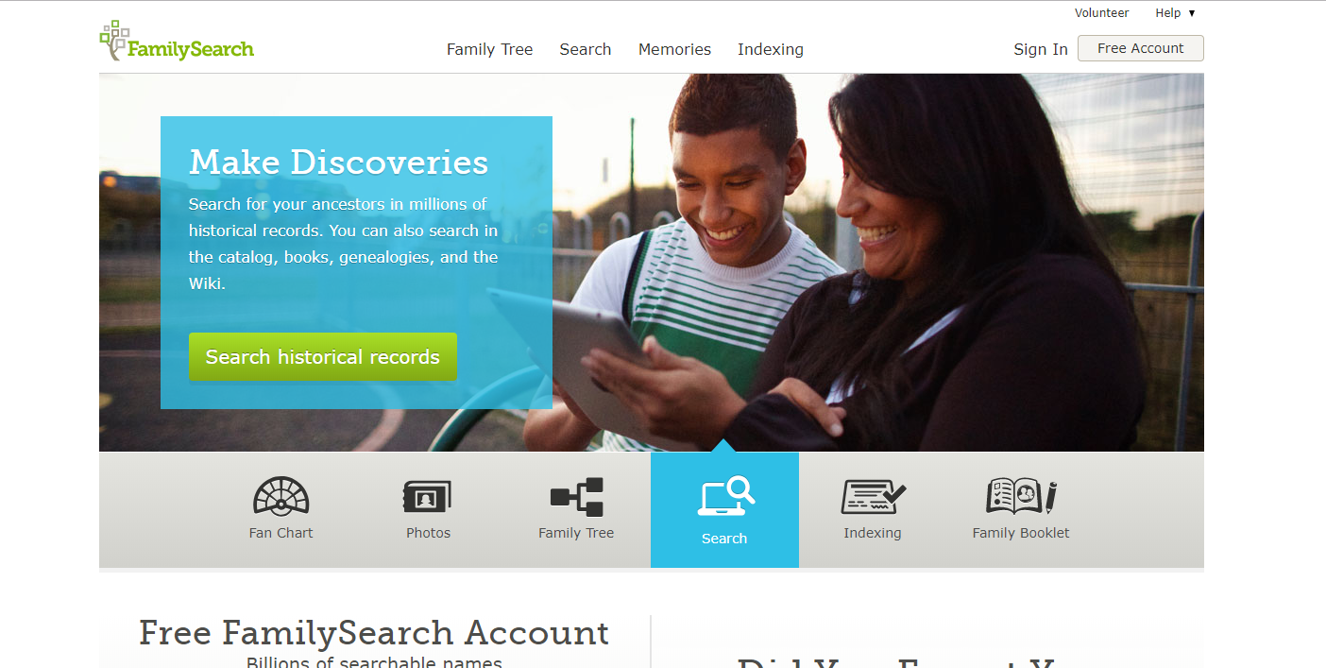
Books on Family Search
www.familysearch.org
Familysearch.org

Slide 5
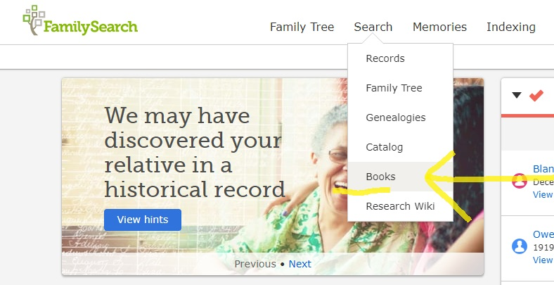
Getting Started:
Sign up for a Family Search account
books.familysearch.org
From Familysearch.org home page

Slide 6
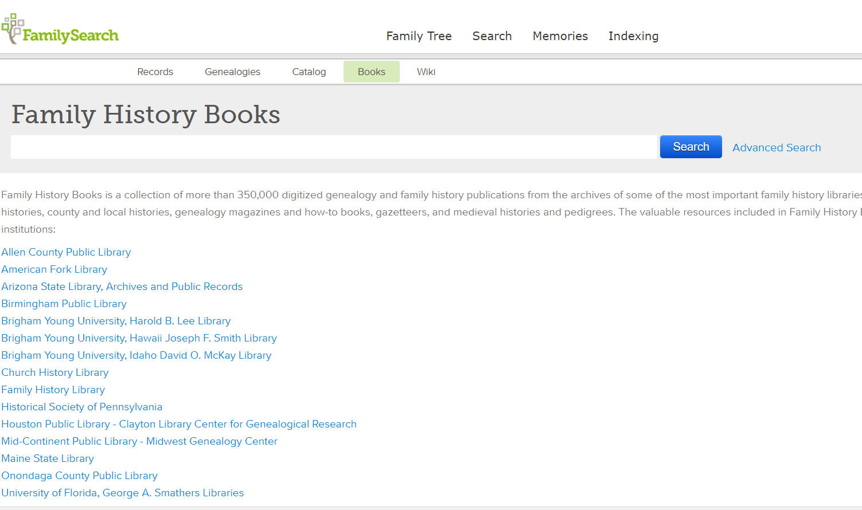
Begin your keyword search here

Slide 7
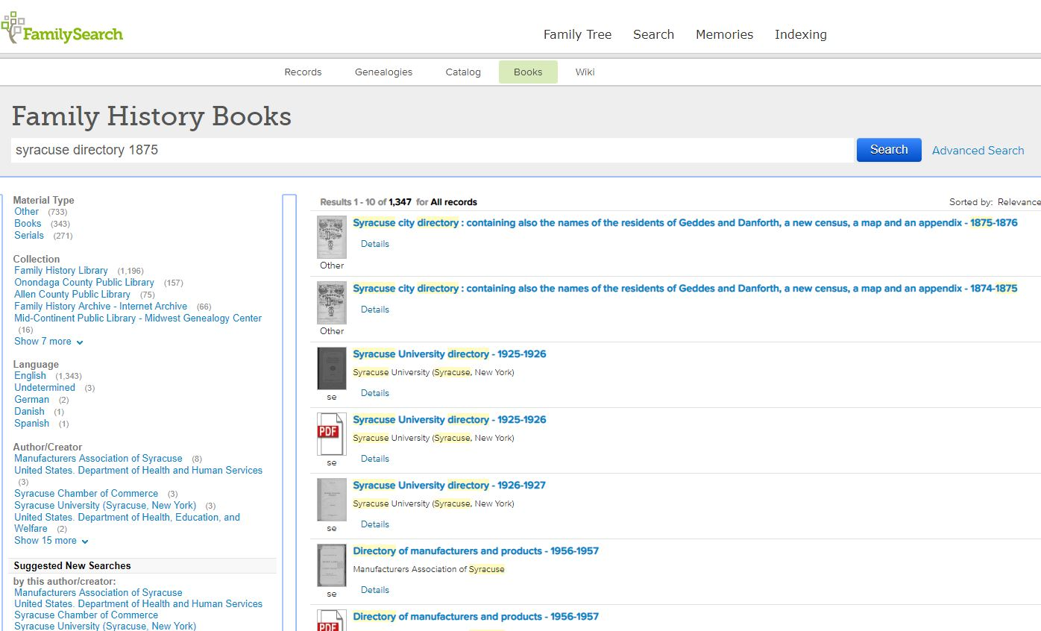
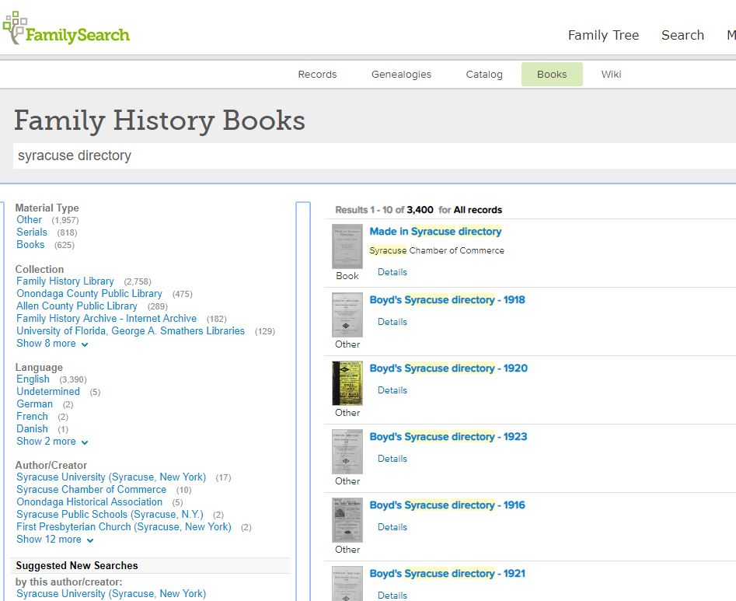

Slide 8
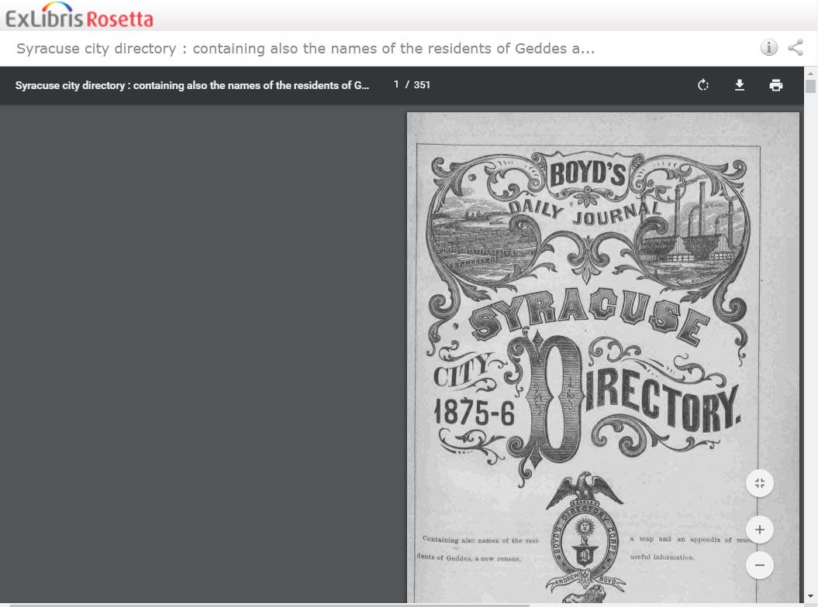
Title and page numbers →
← Download File Option
First page or cover of book →

Slide 9
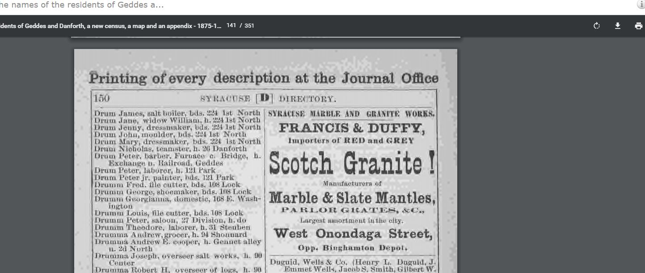
Change page number →
Print – all or specific pages →

Slide 10
Saving book to your computer.
Chose the file location →
Change the file name! →

Slide 11
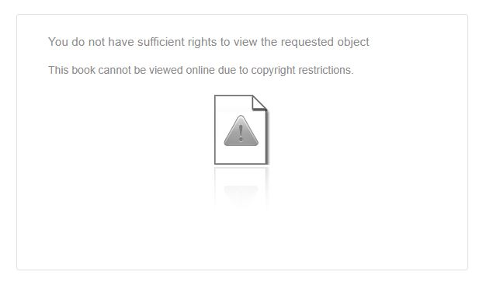
FamilySearch tips and tricks:
PDF Viewer - Adobe Reader
Internet Browsers
Download entire book? Keep unique URL?
Error reading copyrighted books

Slide 12
Searching tips and tricks:
Craft your keyword list: - names - authors - places - dates
More is less.
Use the Family Search limiters – on left side of results
Phrase search with “ parenthesis ”
Try Advanced search if you are stuck – allows some Boolean terms – AND NOT OR
Don’t rely entirely on the machine. THINK! Example: You search for an ancestor that should be in a book but no results. Are they actually not in the book? Or is the tool not finding the name for some reason? The researcher may need to READ THE BOOK.

Slide 13
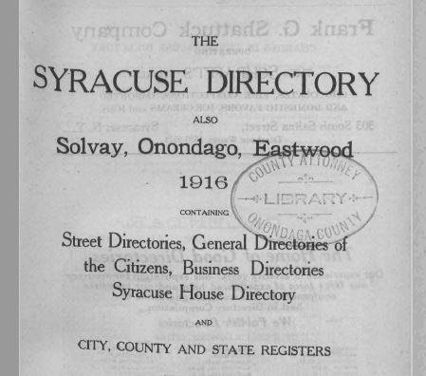
Why can’t I find what I’m looking for?
Errors - spelling variations – human input –unrecognizable characters
Error Messages
Not all books are searchable. Why not?
Family Search uses OCR.

Slide 14
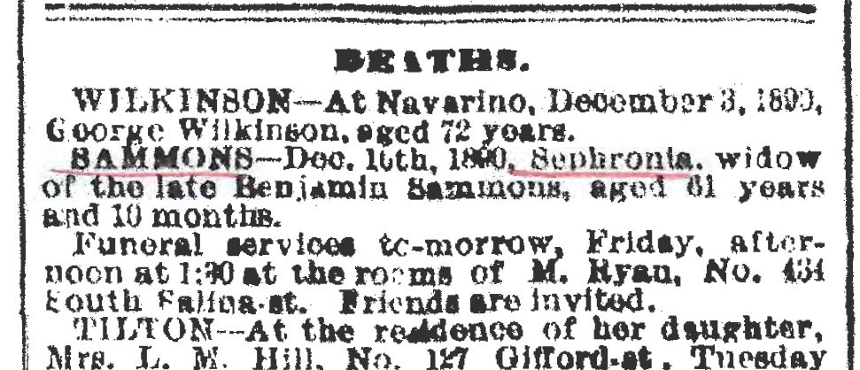
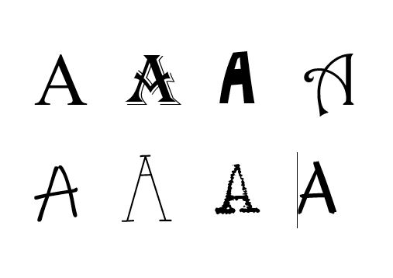
OCR:
Family Search uses OCR – optical character recognition. OCR only works on typed characters OCR does not work on handwriting OCR errors will miss your keyword

Slide 15
Search Examples

Slide 16
Questions?
?

Slide 17
Presenters:
Angela Bailey
Holly Sammons
Barbara Scheibel
For the Central New York Genealogical Society
22 September 2018
A copy of this presentation can be found at:
www.820research.com/cny

